Slide 2
Tour what’s new for XAML tools & Xaml Islands in Visual Studio 2019
Dmitry Lyalin – follow me @lyalindotcom
Sr. Program Manager for Visual Studio XAML Tools (WPF/UWP)

Slide 3
.NET Conf 2019 Desktop Sessions
Day 1
Modernizing .NET Desktop Applications with .NET Core
Speaker: Olia Gavrysh
Get Started with DevOps for .NET Windows Desktop Apps and Visual Studio App Center
Speakers: Daniel Jacobson & Matt Korwel
Day 2
What’s new in XAML tools in Visual Studio 2019 for WPF & UWP
Speaker: Dmitry Lyalin
Day 3
Modernizing .NET Applications with .NET Core - Beyond the Basics
Speaker: Mike Rousos
Tip: Missed a live session? watch on-demand!
Details: https://www.dotnetconf.net/agenda

Slide 4
Session Agenda
What’s New
Tour through XAML Tools with what’s new for XAML developers (Hot Reload, Designer & Code Editor)
Modernizing your existing apps with .NET Core, XAML Islands
Looking Forward
WinUI 2.x & beyond
Tooling roadmap – what’s coming to XAML Tools?
Make your voice heard

Slide 5
Tour through XAML Tools

Slide 6
Visual Studio 2019
XAML Designers
XAML Code Editors
XAML Hot Reload

Slide 7
XAML Suggested Actions

Slide 8
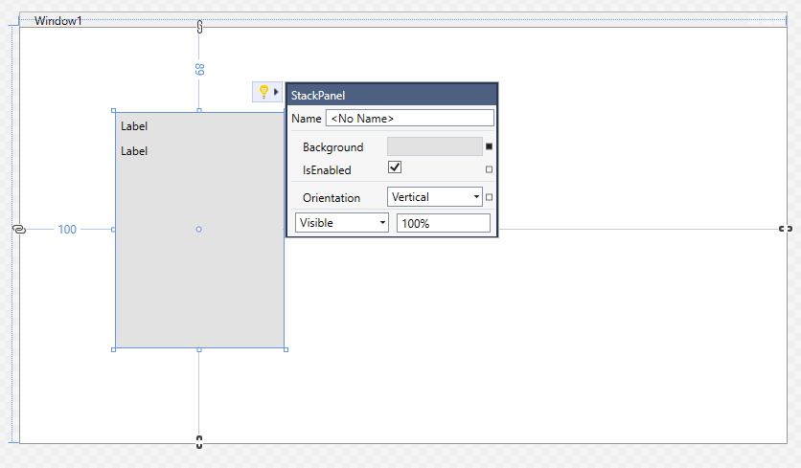

Slide 9
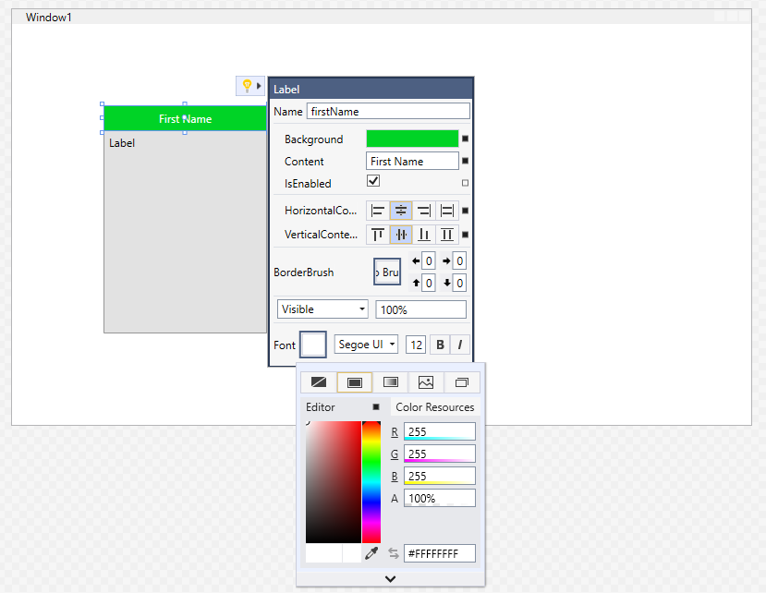

Slide 10
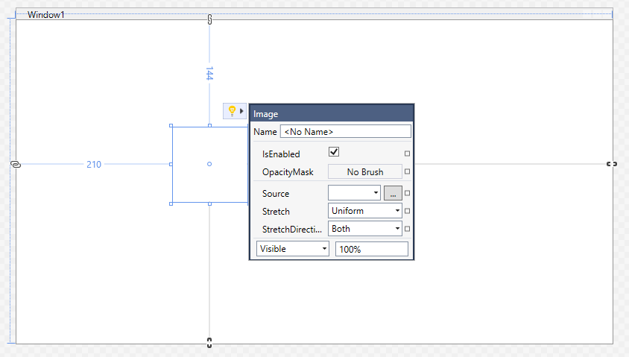

Slide 11
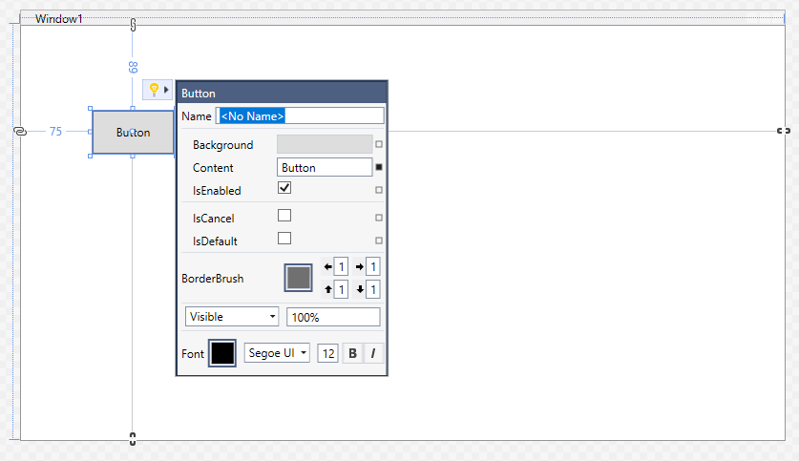

Slide 12
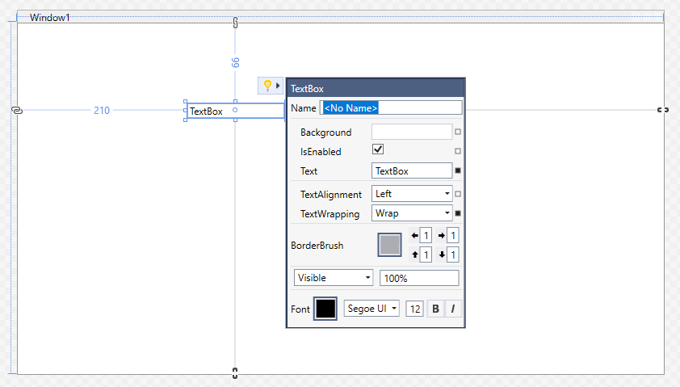

Slide 13
XAML Suggested Actions
First preview will support: Border, Button, Canvas, ComboBox, Grid, Image, Label, ListBox, ListView, StackPanel, TextBlock, TextBox
Coming under feature flag in future releases (16.4 future previews most likely)
What’s Next?
Support more controls + actions (think creating new tab in tab control)
Adding extensibility

Slide 14
Demo Time!

Slide 15
Recap
XAML Designer
WPF Core – Designer GA
Suggested Actions – coming in future releases
XAML Code Editor
IntelliCode, #regions
Hot Reload + Tools == winning
In-app toolbar, Live Visual Tree & Live Property Explorer
Hot Reload for WPF Framework, WPF Core &UWP
Editing/Creating Resources now works for WPF
Editing x:bind now works for UWP (if project is targeting 1809+)

Slide 16
Resources
XAML Hot Reload: https://aka.ms/docs-hotreload
XAML Designer: https://aka.ms/docs-xamldesigner
XAML Live Editing Tools (Live Visual Tree, In-app toolbar, etc.): https://aka.ms/docs-xamllivetools

Slide 17
Modernizing your existing apps: XAML Islands

Slide 18
XAML Islands 1.0
UWP
MSIX
WinRT Components
UWP app model
Win32
WinForms
WPF
Activation
ASTA Model
Package ID
Certificate
Run-Resume-Susp
WinRT APIs
AppContainer
UWP
XAML
UWP
XAML
UWP
XAML
PRI
Resw
MRT
Store
UWP
XAML
Input
Win32 app model
…
Comp

Slide 19
XAML Islands Components
Windows shipped
App developer code
UWP Custom Controls
WinUI controls
WPF app
WinForms app
C++ Win32 app
WPF Control Wrappers
WinForms Control Wrappers
WPF XAML Host
WinForms XAML Host
App code
HWnd
Windows 10 Platform
Xaml Hosting API
Inbox Xaml Controls

Slide 20
UWP XAML today
WPF app
WinForms app
C++ Win32 app
UWP app
🏝
🏝
🏝
UWP XAML Custom Controls
WinUI 2.x
New XAML Controls
App code
Windows 10 Platform
Xaml Framework
Xaml Hosting APIs
Xaml Controls
Composition, Animation, Input
Windows 10 Subsystems: DirectX, kernel, drivers, device access, …
1507 | 1511 | 1607 | 1703 | 1709 | 1803 | 1809 | 1903

Slide 21



.NET Wrappers Controls
UWP controls wrapped into Windows Forms or WPF controls, hiding UWP concepts from the developer.
WebView and WebViewCompatible
InkCanvas and InkToolbar
MediaPlayerElement
MapControl
Microsoft.Toolkit.Forms.UI.Controls
Microsoft.Toolkit.Forms.UI.Controls.WebView
Microsoft.Toolkit.Wpf.UI.Controls
Microsoft.Toolkit.Wpf.UI.Controls.WebView

Slide 22
.NET XAML Islands Hosting Controls
Allow most of the built-in and 3rd party UWP XAML controls be hosted in a XAML Island. WinUI 2.x controls can be hosted as well
<Window …
xmlns:xaml="clr-namespace:Microsoft.Toolkit.Wpf.UI.XamlHost;assembly=Microsoft.Toolkit.Wpf.UI.XamlHost"
…>
<Grid>
<xaml:WindowsXamlHost InitialTypeName="AppUIBasics.NavigationRootPage" />
</Grid>
</Window>
Microsoft.Toolkit.Wpf.UI.XamlHost
Microsoft.Toolkit.Forms.UI.XamlHost
Microsoft.Toolkit.Win32.UI.XamlApplication
(allows XAML Application run on Islands)

Slide 23
Demo Time!

Slide 24
Limitations XAML Islands v1
WebView inside of an XAML Island
Support Connected Animations
Inline inking textboxes
Make Acrylic and Reveal work in 3rd parties
Make UWP ContentDialogs modal
Improve Light dismiss for flyouts
3rd party WinRT components support for v1
Desktop App Type | 3rd Party WinRT Components
 | Managed | Native
Native Win32 | ❌ | ✔
Managed .NET Framework | ❌ | ✔*
Managed .NET Core 3 | ✔ | ✔

Slide 25
Resources
https://aka.ms/docs-xamlislands

Slide 26
Looking Forward

Slide 27
Future Tooling Improvement
Under Consideration (no ETA)
Making it easier to debug data binding problems in the running apps
Making it easier to merge resource dictionaries
Drag Image to XAML
Improved IntelliSense for XAML #regions
Fit all default behavior for XAML Designer
Just Exploring…
Adding Color visualizers to XAML editor
Bringing Blend Rulers/Guidelines to VS
Enabling Live Visual Tree to visualize mixed framework apps
Expanding design-time data options for WPF/UWP apps

Slide 28
What’s next with platform
WinUI 3.0
XAML Islands 2.0
https://github.com/microsoft/microsoft-ui-xaml

Slide 29
Monthly .NET Desktop Community Standup
Monthly conversation about desktop development hosted by Olia and Dmitry
Monthly, every 4th Thursday
Recent topics include .NET Core for Desktop apps, WinUI roadmap, XAML Islands Overview and much more to come
http://aka.ms/DesktopCommunityStandup

Slide 30
Thank You!
dmitry.lyalin@microsoft.com
@lyalindotcom

